Slide 1
Machine Learning for Newsrooms
Jonathan Soma
Columbia University
js4571@columbia.edu
@dangerscarf

Slide 2
Machine learning: what and why?

Slide 3
What is M.L.?
Machine learning
Artificial intelligence
Fancy statistics
Not-so-fancy statistics
Almost everything!

Slide 4
Two use cases
ML for Business
ML for Investigations
Conversion rates
Article summaries
Content creation/article generation
Uncovering unusual data points
Finding bias
Doing large amounts of work, relatively quickly and easier

Slide 5




How M.L. works
INPUT
MAGIC BOX OF
MACHINE
LEARNING!
OUTPUT

Slide 6
Be a journalist, not a statistician or data scientist

Slide 7





$7
+ tip
$12
+ tip
$15
+ tip

Slide 8
“Training” a “model”
$5
$14
$3
$12
$17
$12
$12
$20
$18
$42
$9

Slide 9
What is a “model”?
INPUT
MAGIC BOX OF
MACHINE
LEARNING!
OUTPUT

Slide 10
It’s not the tool, it’s how you use it.

Slide 11
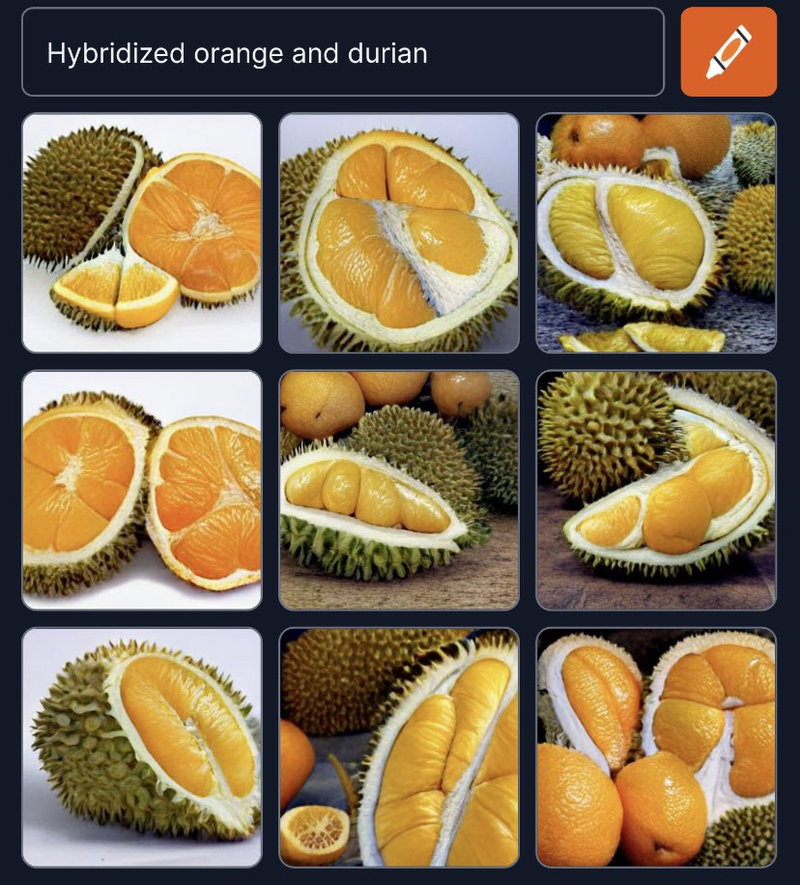
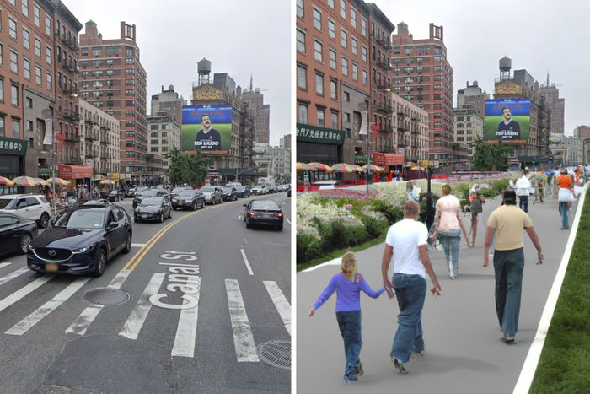
DALL-E, midjourney

Slide 12
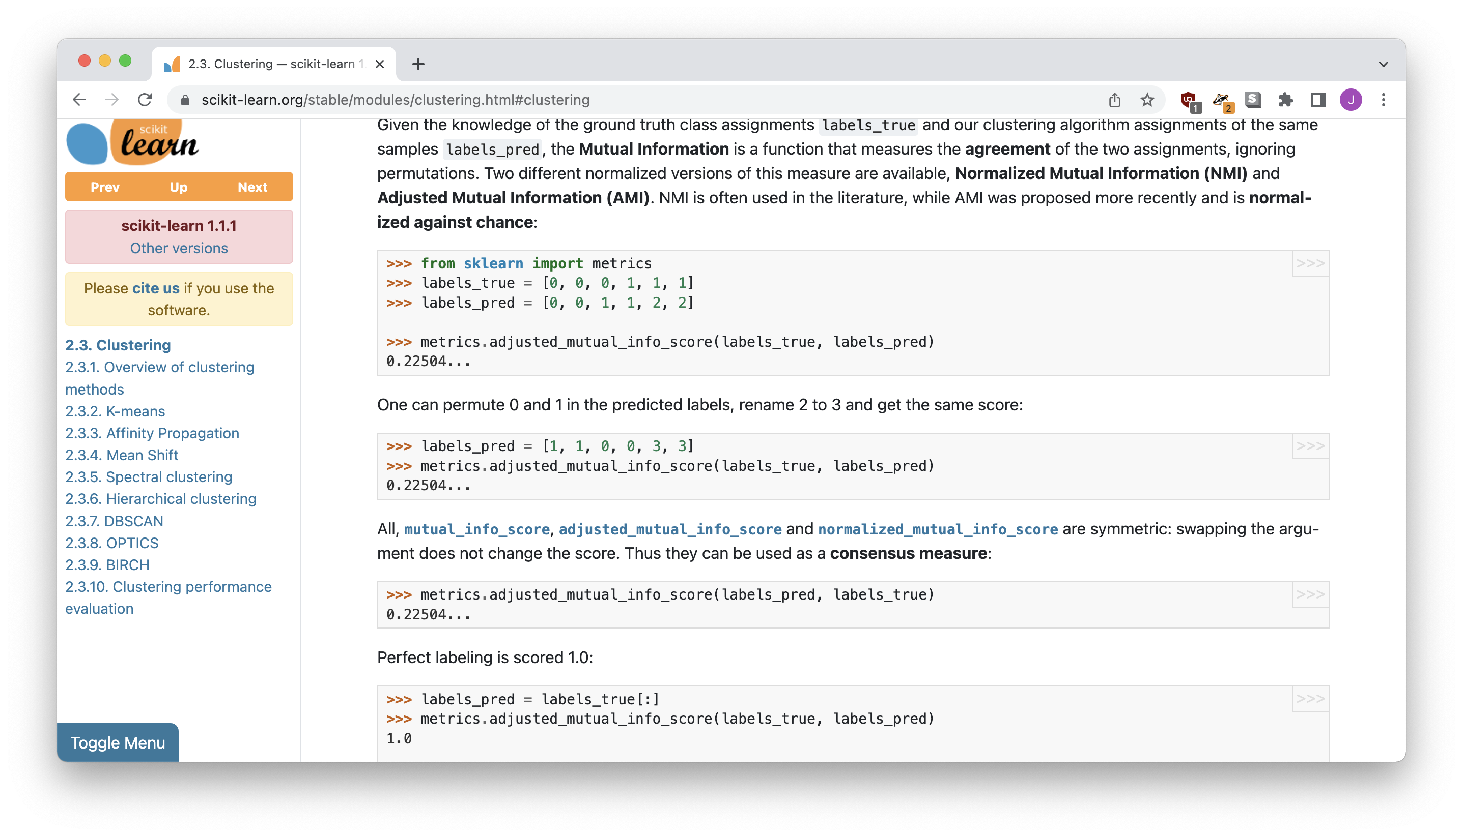
sklearn, tensorflow

Slide 13
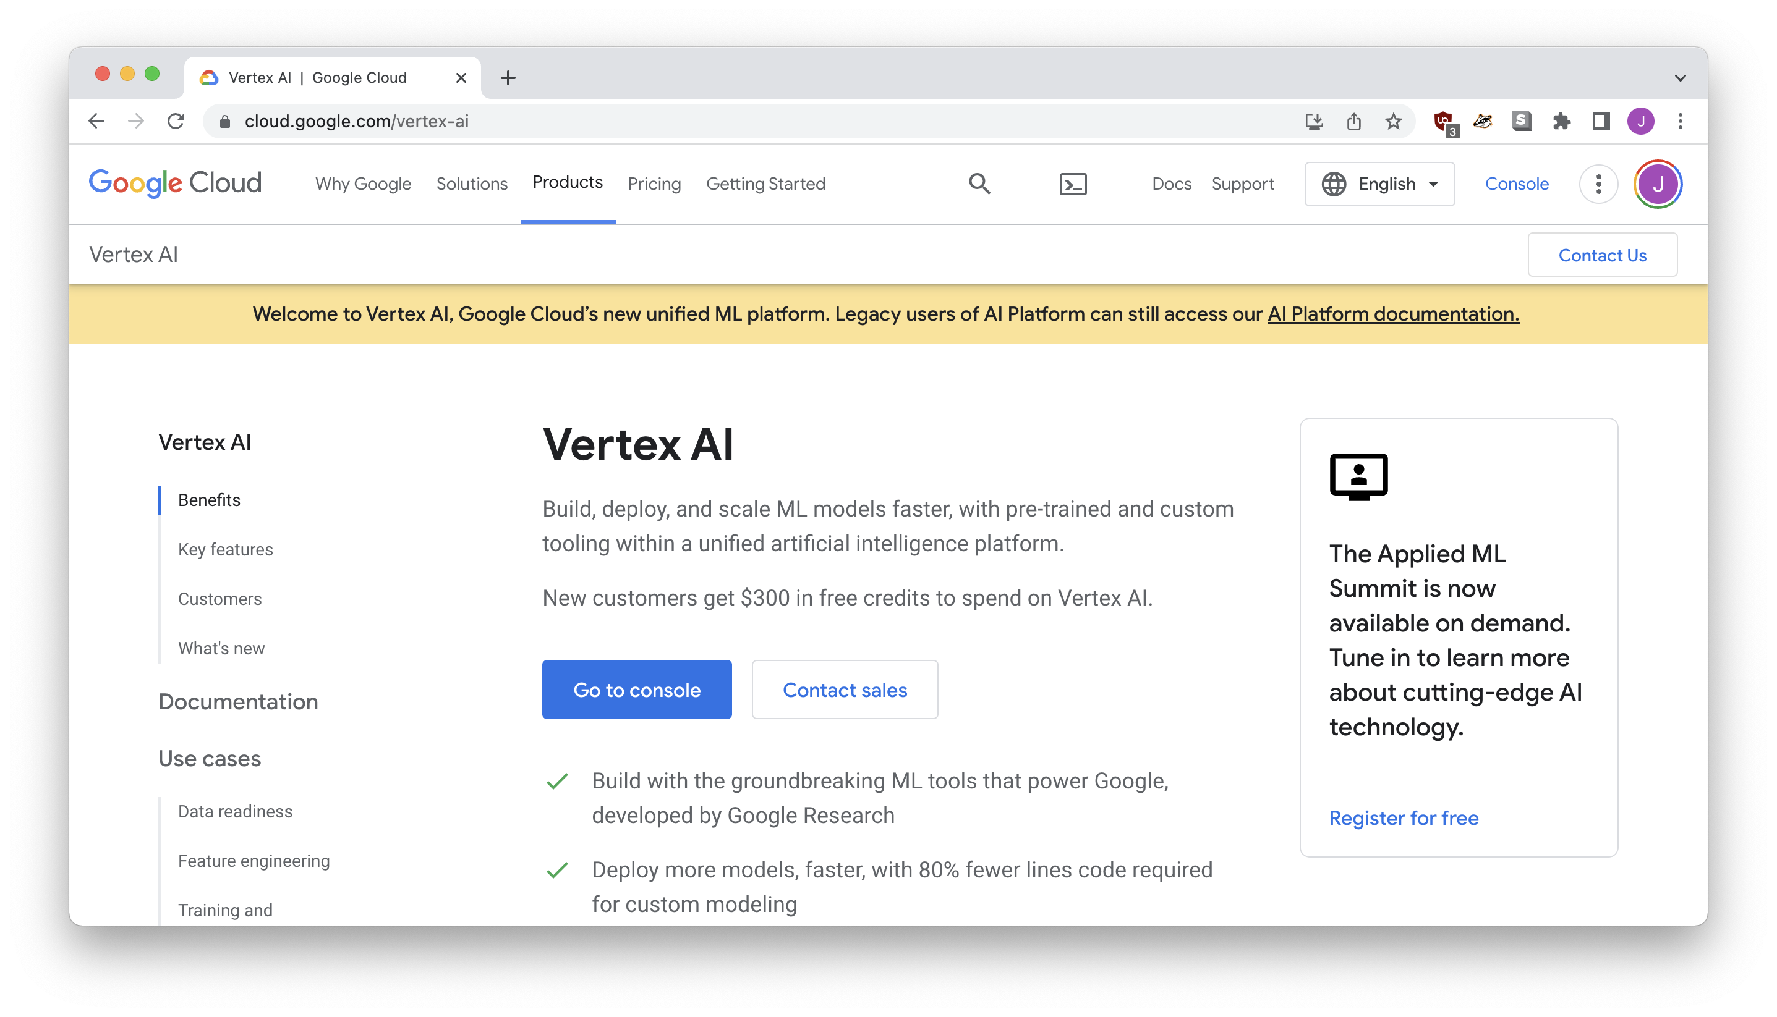
Refinery, VERTEX AI, etc…

Slide 14
Caution: The machine only reproduces what it’s seen.

Slide 15
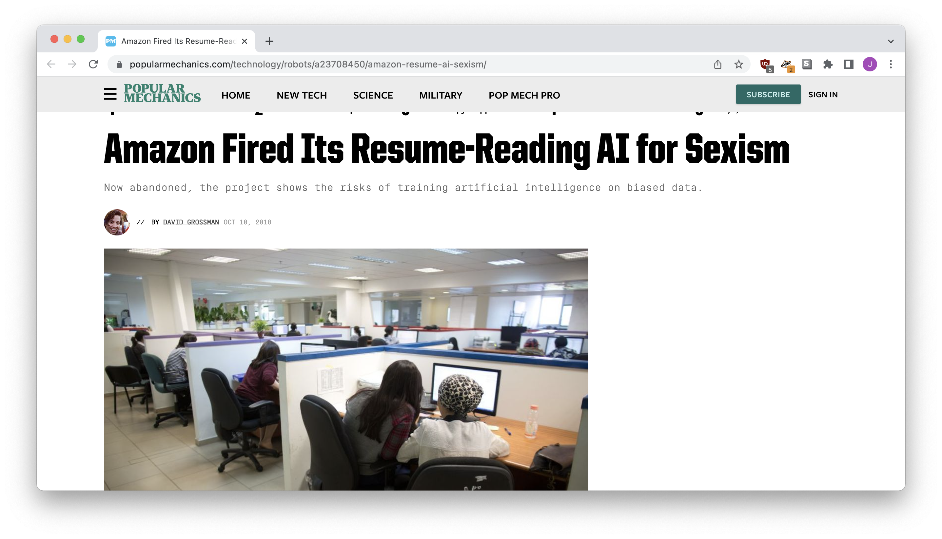
resume screener
Notes:
https://www.popularmechanics.com/technology/robots/a23708450/amazon-resume-ai-sexism/

Slide 16
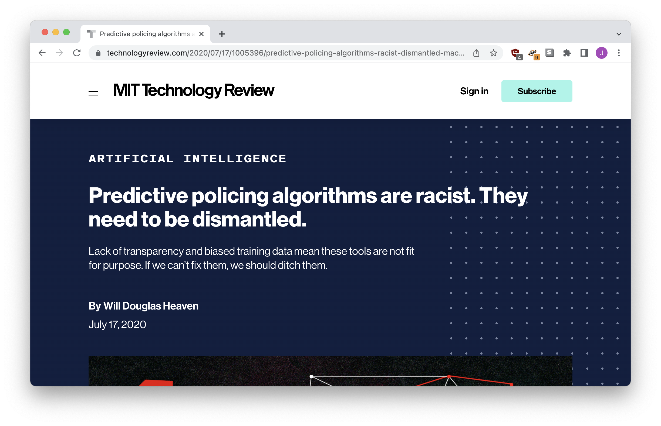
“Bias laundering”
Notes:
https://www.technologyreview.com/2020/07/17/1005396/predictive-policing-algorithms-racist-dismantled-machine-learning-bias-criminal-justice/

Slide 17
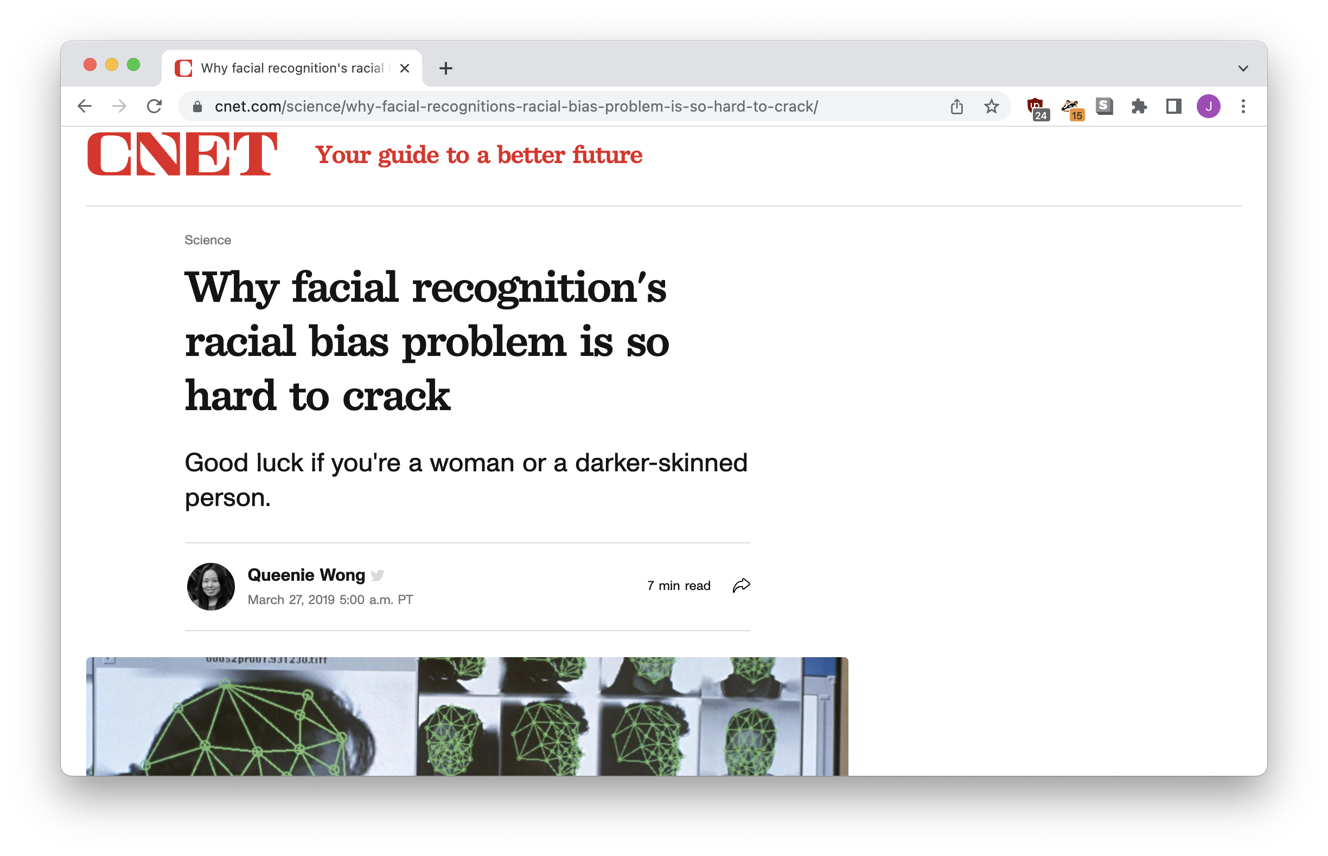
Is your data complete?

Slide 18
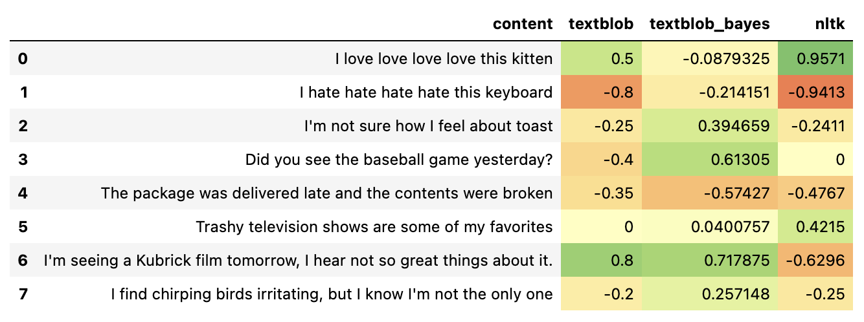
Where’s your data from?
Notes:
Textblob: Words in customer reviews
Textblob + Baytes: Words in movie reviews, rated by stars
NLTK: List of words, rated
https://investigate.ai/investigating-sentiment-analysis/comparing-sentiment-analysis-tools/

Slide 19

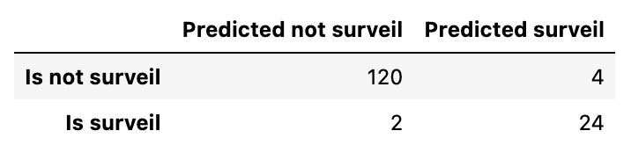
“Testing” your model
Notes:
Optimizing for metrics

Slide 20
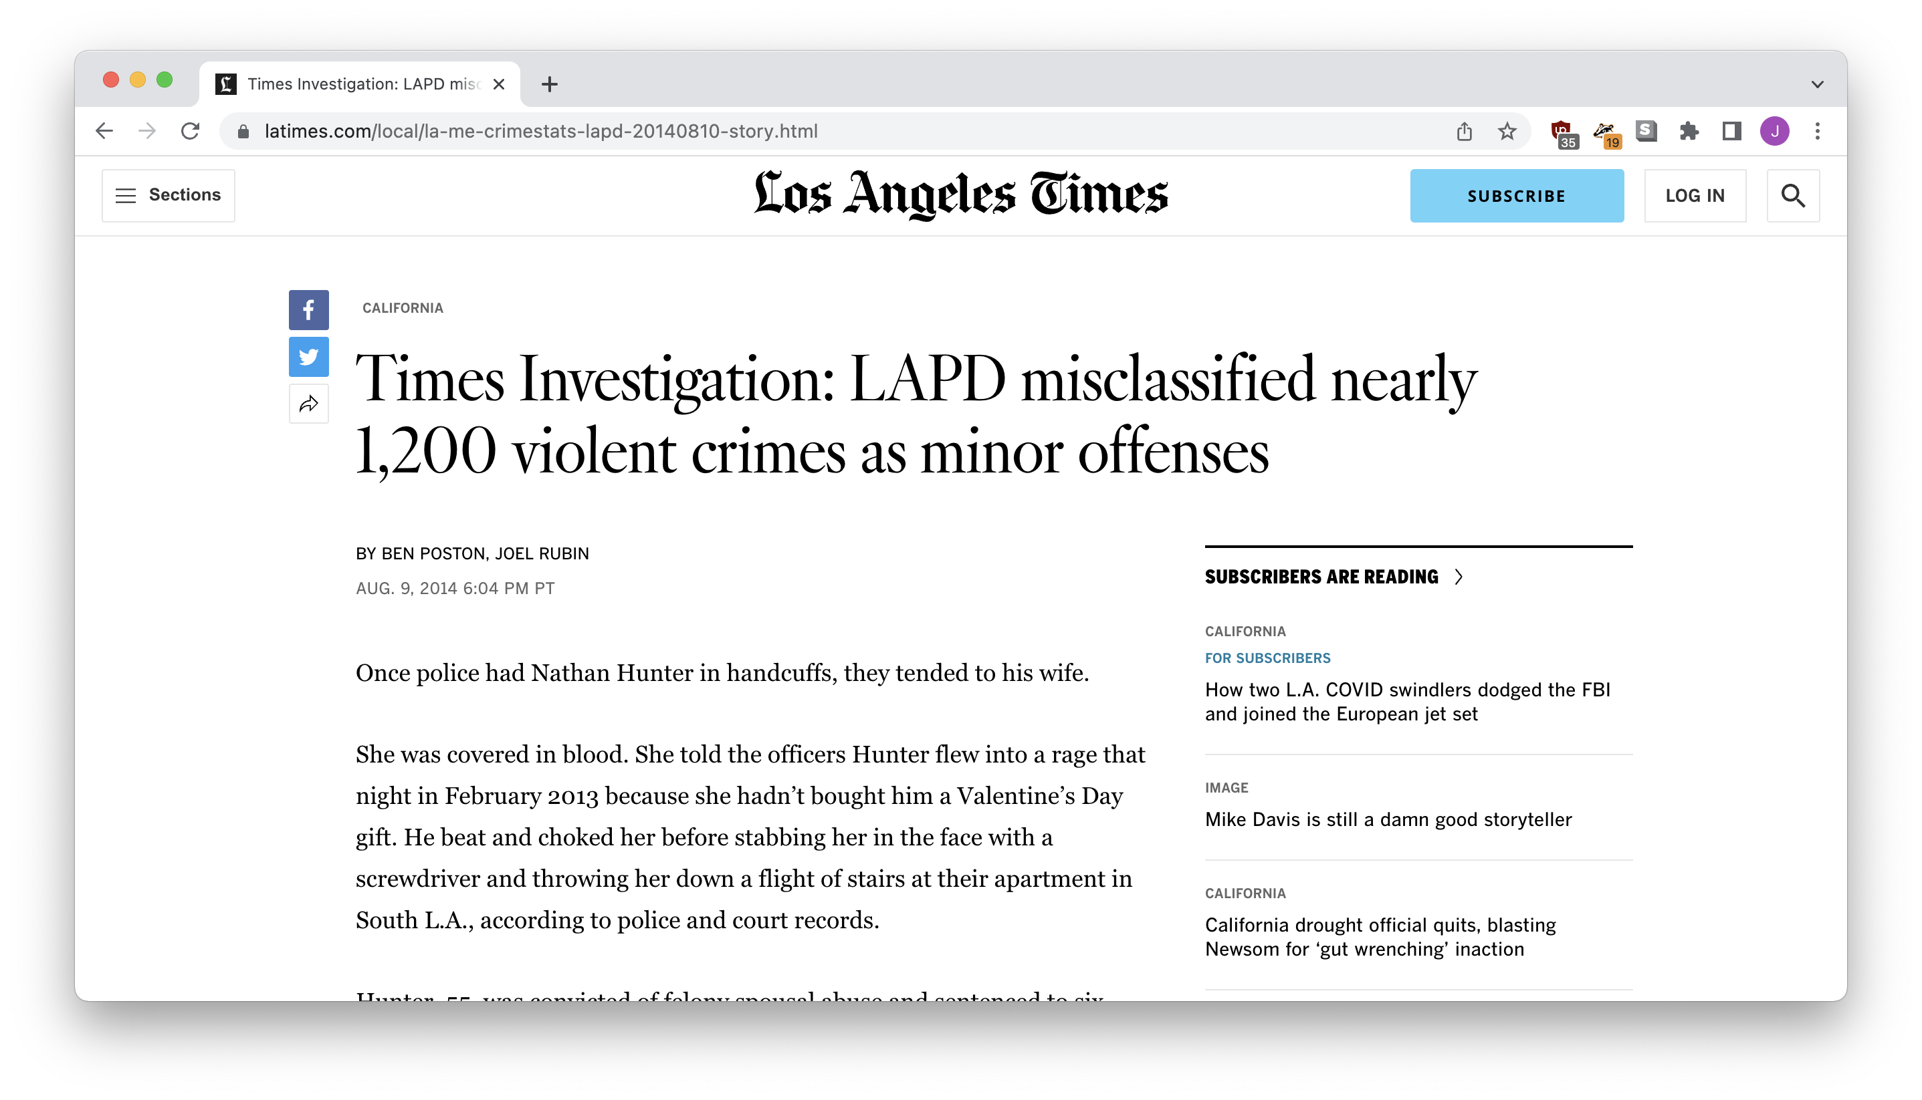
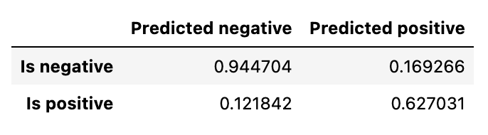
“Testing” your model
Notes:
Optimizing for metrics

Slide 21
Let’s produce some stories!

Slide 22
Finding unusual data
Does reality match what you’d expect?
Collect your data
Train your model
Make predictions: what outcomes doesn’t match?

Slide 23
Finding bias
What really affects an outcome?
Find a situation where the outcome might be biased
Decide what might affect the outcome
Collect your data
Train your model
What inputs are most important to the outcome?

Slide 24
Automating workflows
Tell the computer: “do what I just did, but faster”
Collect the data you’d like to organize or sort
Label some of the items
Train your model
Predict labels for the unlabeled data

